Slide 1


Capstone
Project

Slide 2



Personal BACKGROUND
Name : Rajat Lad
Past Experience : Experience in previous Trainings with Angular and JAVA Spring Boot.
Qualification : Bachelor of Engineering in ECE
www.collaberadigital.com

Slide 3


Problem Statement of the Capstone Project
Demonstrate end-to-end Quality Engineering skills with automated testing for web and APIs.
Develop scalable Selenium WebDriver UI tests using Page Object Model, logging, and assertions.
Create Postman API automation collections and run via Newman locally.
Manage test execution, reporting, and tracking using Jira and Xray.
Optionally implemented performance testing (JMeter).
Integrate tests and code into GitHub

Slide 4
Reference Links :
Links
🔗 Web Application
https://opensource-demo.orangehrmlive.com/web/index.php/auth/login
🔗 API Base URL
https://reqres.in/
🔗 GitHub Repository
https://github.com/asc08rajat/CAPSTONE_COGNIXIA_WEB_API_MAY2025_RAJAT

Slide 5
Selenium Web UI Test Automation – Overview
Tech Stack: Java • Selenium WebDriver • TestNG • Maven
Design Pattern: Page Object Model (POM)
Features:
Automated tests for login, Add user, Search User, Logout
TestNG assertions and execution via testng_capstone.xml
Log4j logging for traceability
Headless mode and Headed via config.properties
Execution:
Run with: mvn test -Dsurefire.suiteXmlFiles=testng_capstone.xml

Slide 6
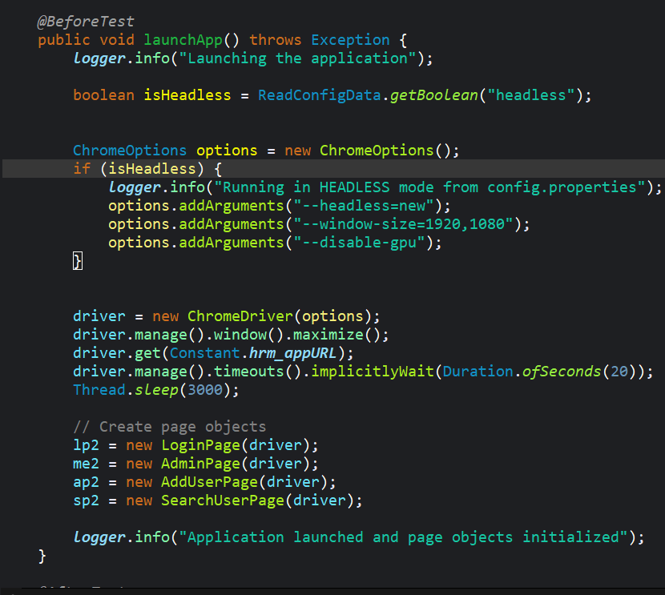
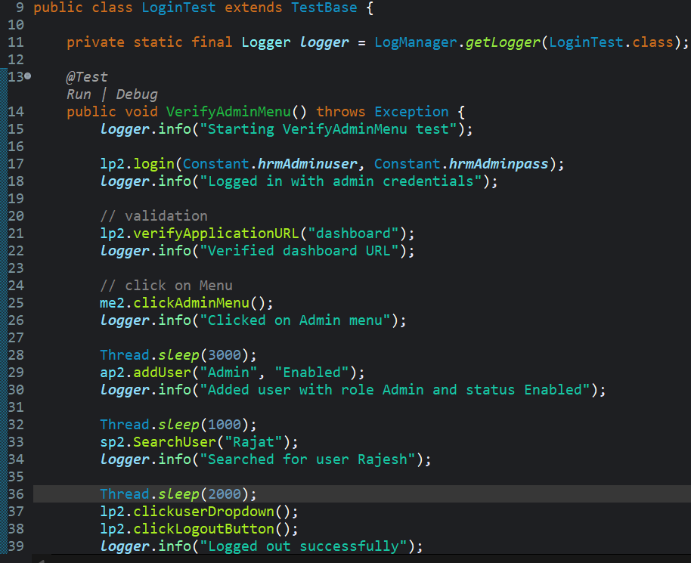
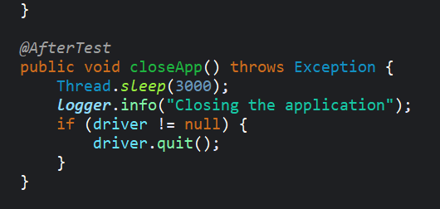
Test Base.Java
LoginTest.Java

Slide 7
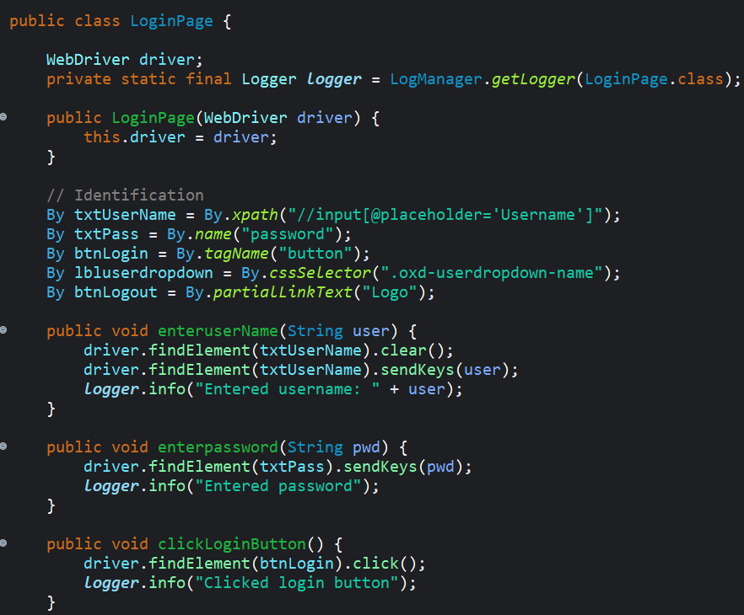
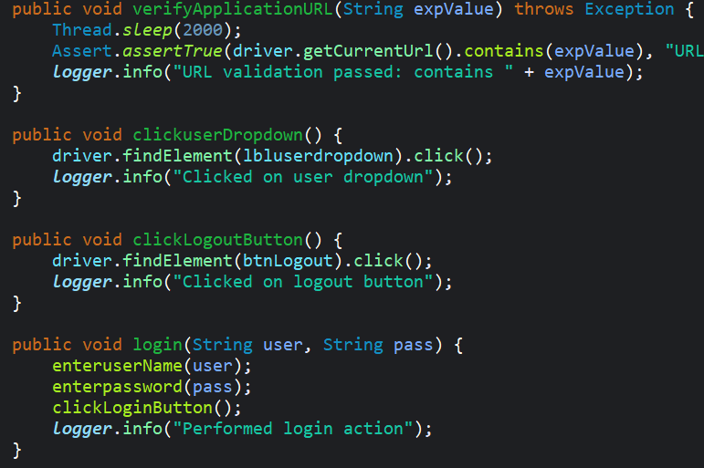
Login and Logout Functionality Using Page Object Model

Slide 8
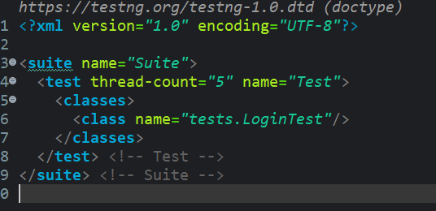
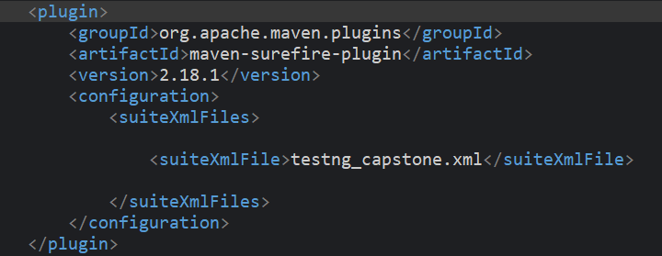
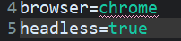
Testng_capstone.xml
Maven-Surefire plugin in Pom.xml
config.properties

Slide 9
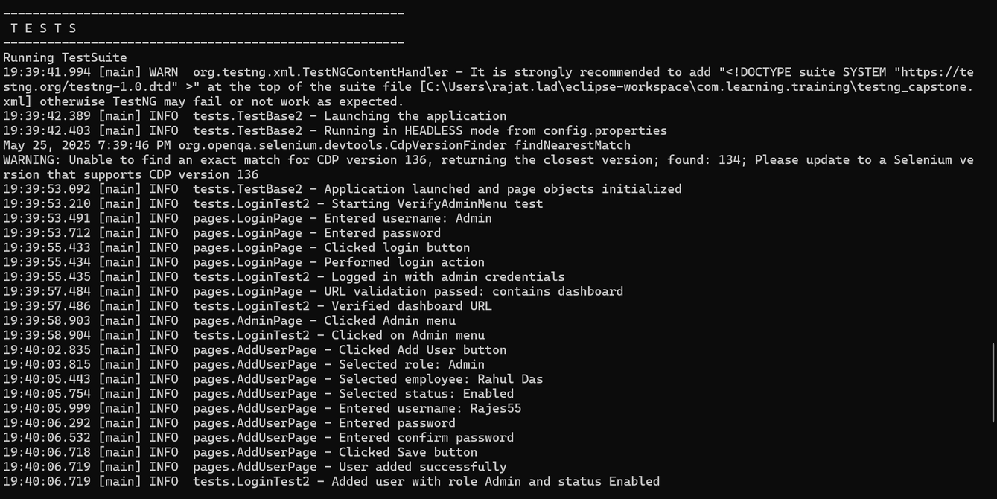
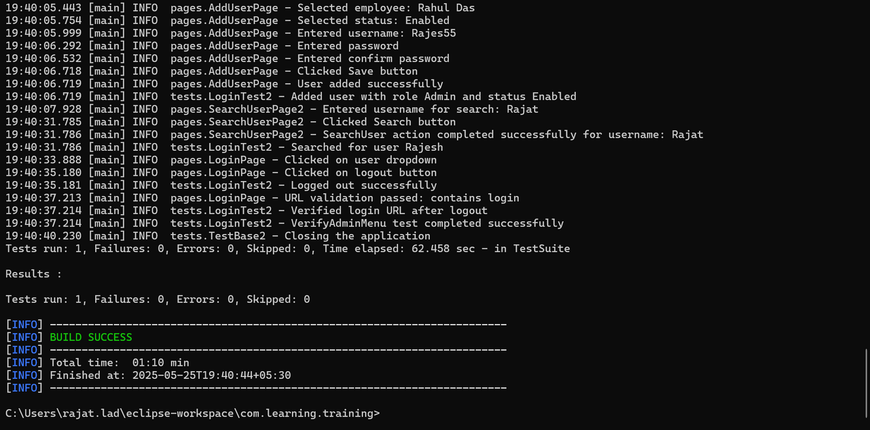
Test Results of the selenium project
Executed test from Command prompt.
Executed test in both Headless and Headed.
Run with: mvn test -Dsurefire.suiteXmlFiles=testng_capstone.xml

Slide 10
API Automation – Postman + Newman (CLI)
Tech Stack:
Postman
Newman CLI
Validation Checks:
HTTP Status Codes: 200, 201
Response Body Content: e.g. Sanchi
Response Time: under 2000ms
Header Assertions: Content-Type: application/json
Requests Automated:
GET /users — Fetch all users
POST /user — Add a new user
GET /users/{{userID}} — Fetch user by ID
PATCH /users/{{userID}} — Update user by ID
DELETE /users/{{userID}} — Delete user by ID
COMMAND LINE EXECUTION:​
​
RUN NEWMAN VIA CMD​
​
GENERATE HTML REPORT ​
​
STORE OUTPUT AT NEWMAN FOLDER​

Slide 11
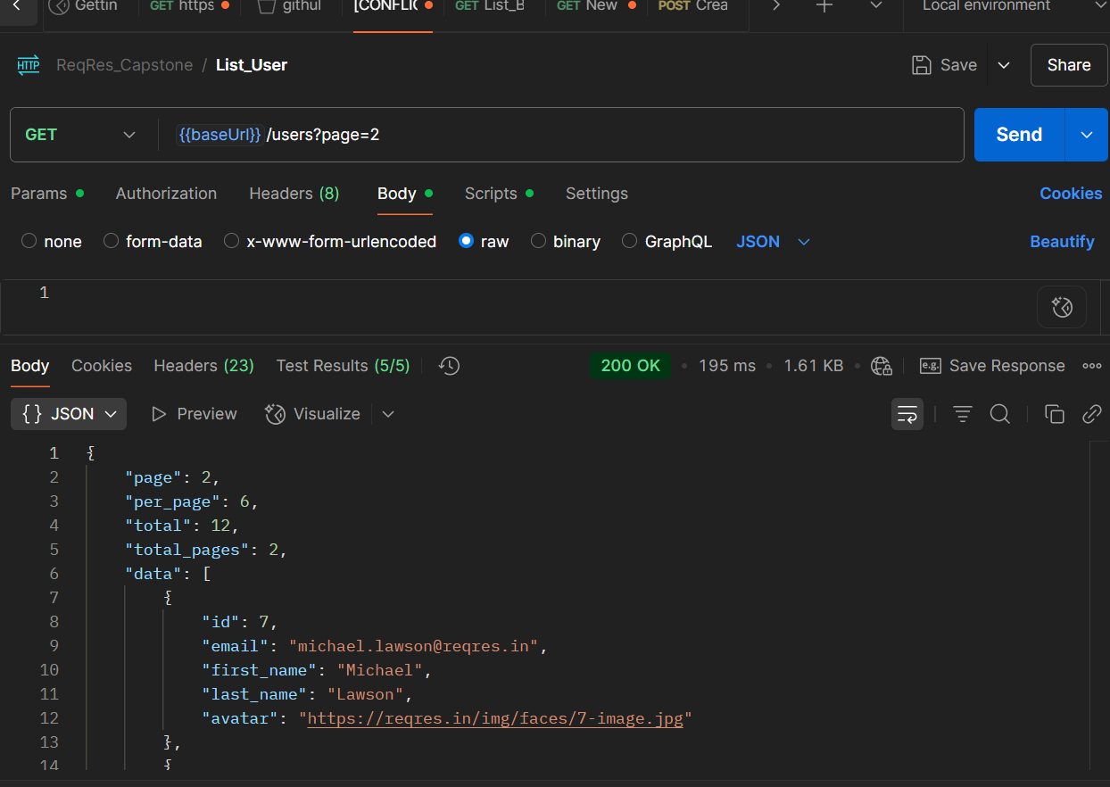
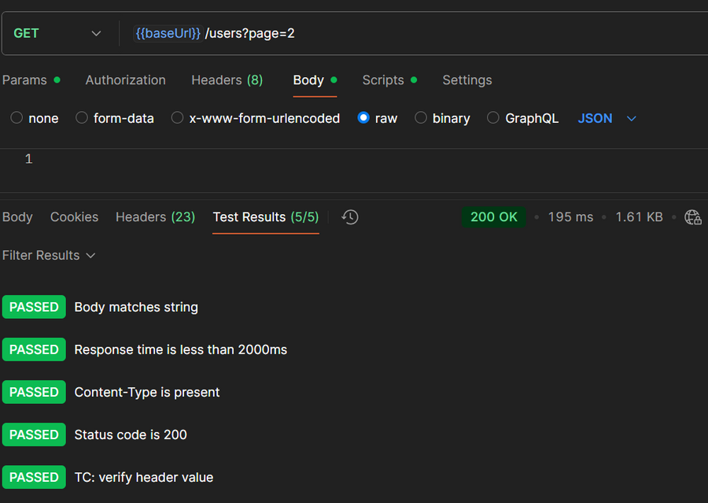
Postman Request Methods, Responses of the API with screenshots
API USED : https://reqres.in/
GET Request

Slide 12
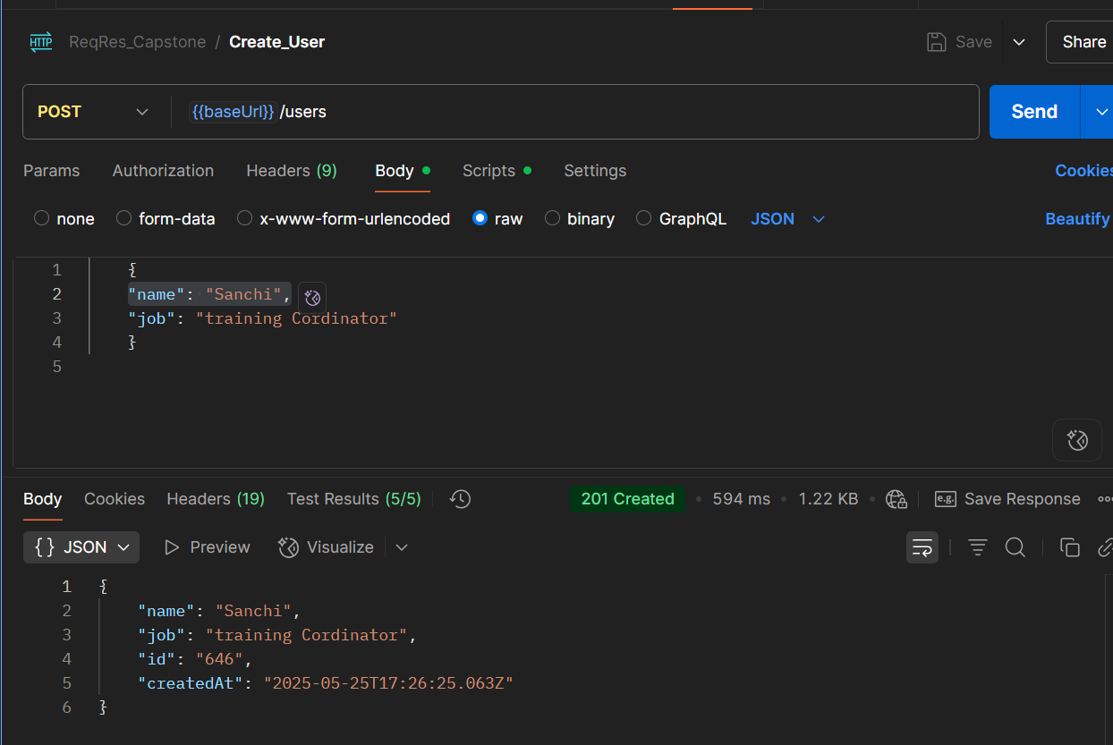
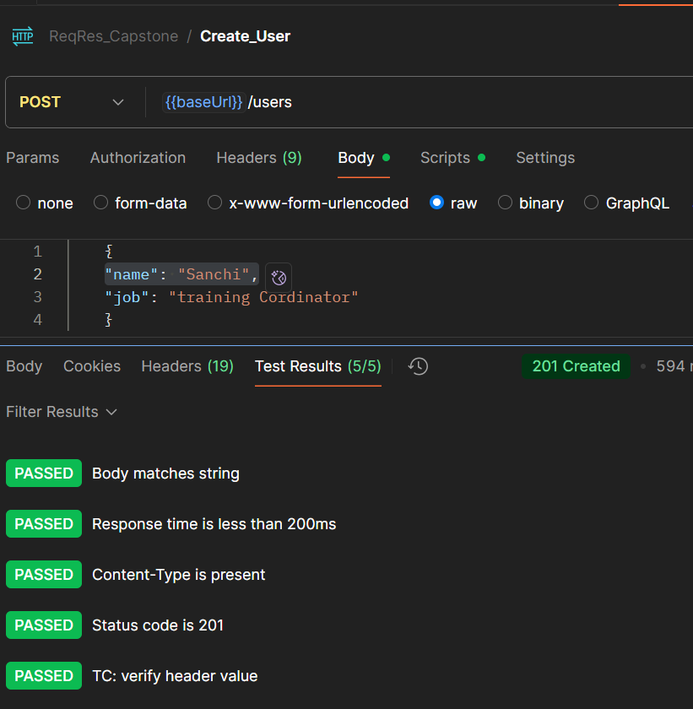
Postman Request Methods, Responses of the API with screenshots
API USED : https://reqres.in/
POST Request

Slide 13
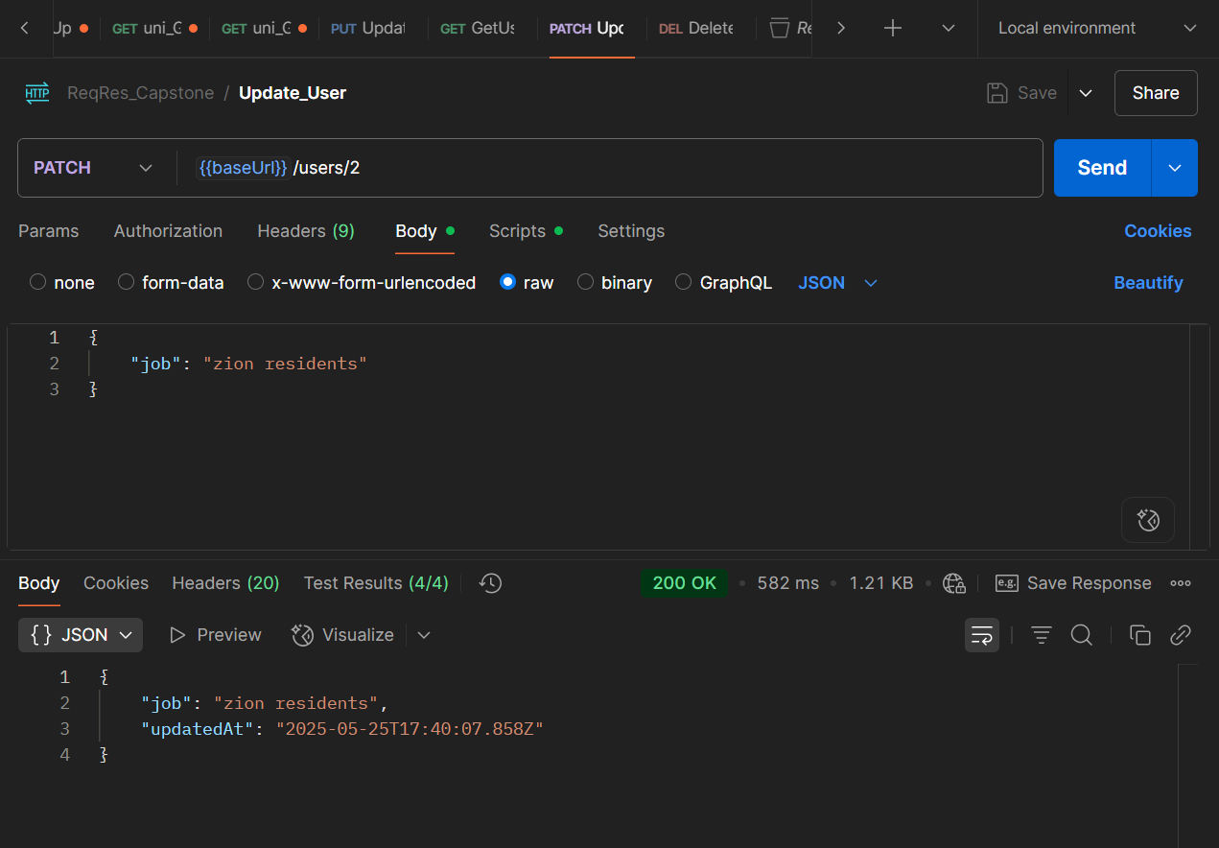
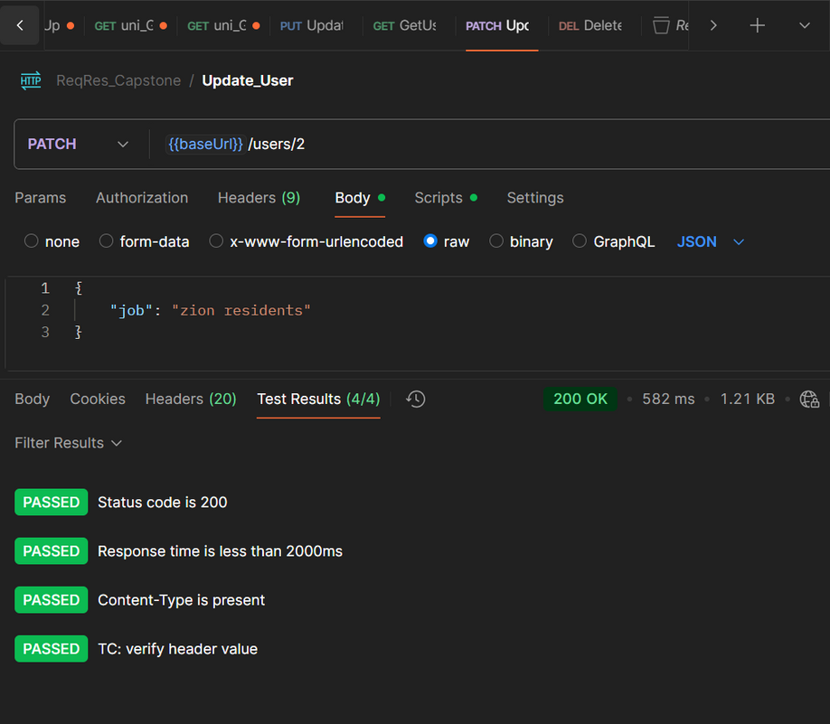
Postman Request Methods, Responses of the API with screenshots
API USED : https://reqres.in/
PATCH Request

Slide 14
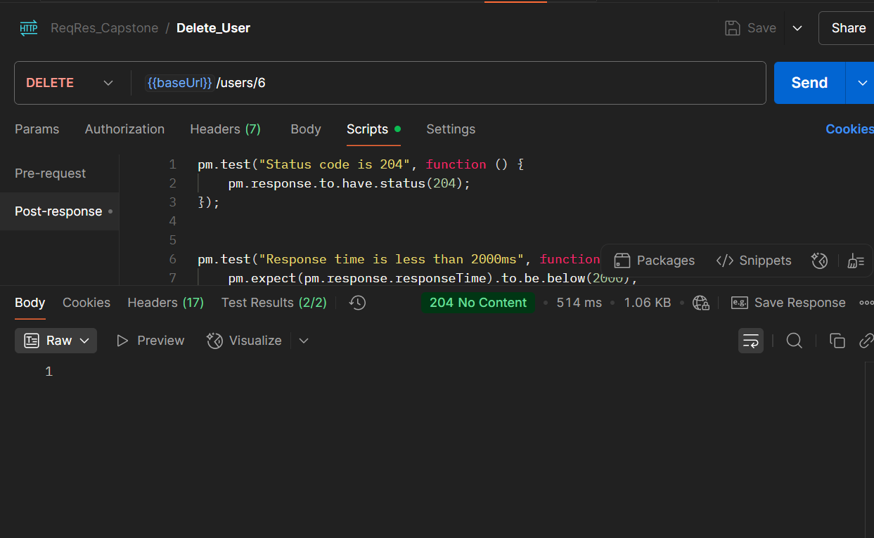
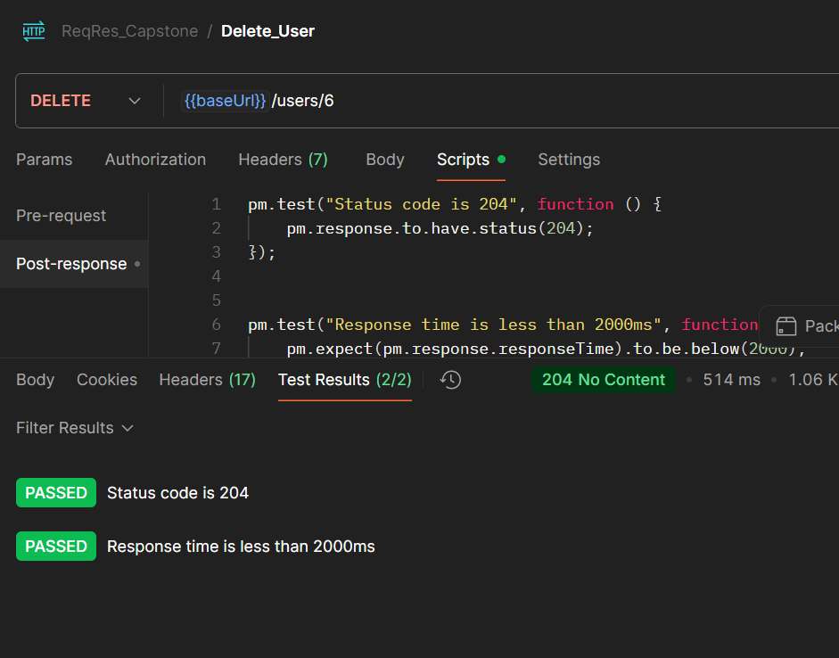
Postman Request Methods, Responses of the API with screenshots
API USED : https://reqres.in/
DELETE Request

Slide 15
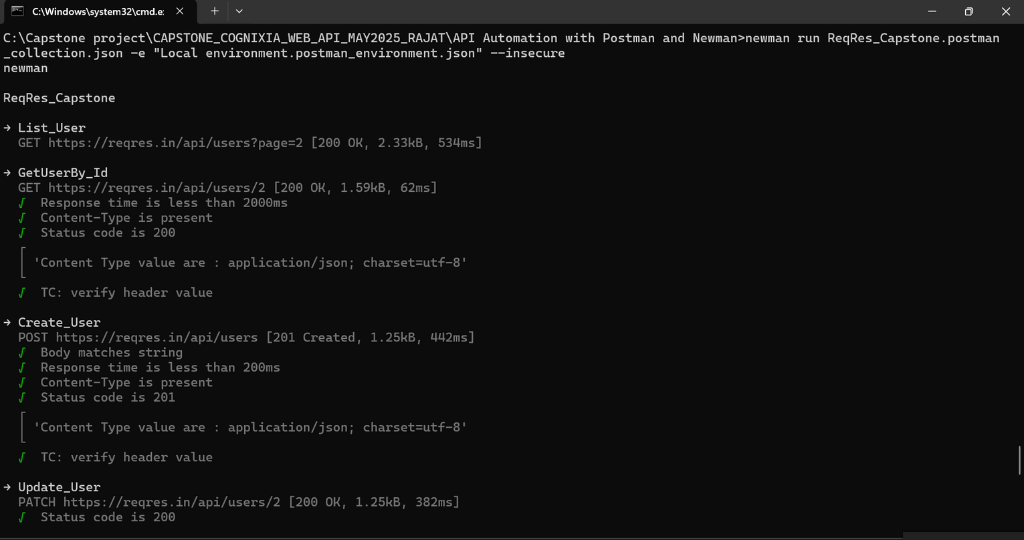
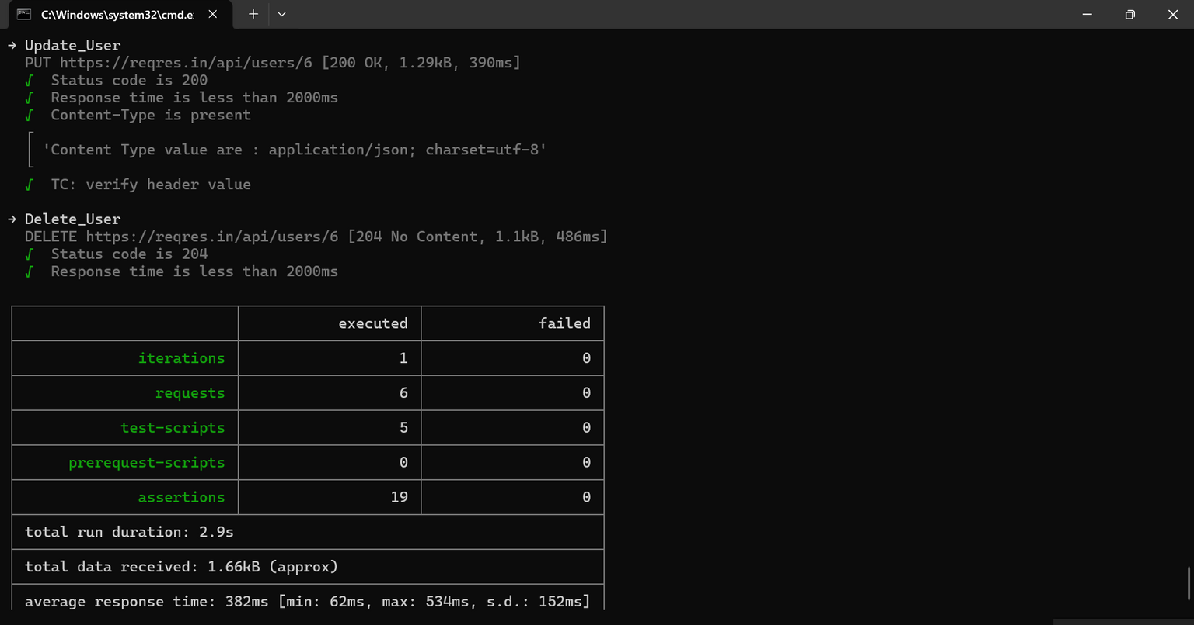
EXECUTING THE EXPORTED COLLECTION IN CMD FROM POSTMAN USING NEWMAN ​
newman exe cmd

Slide 16
Performance Testing – Apache JMeter
Tool: Apache JMeter (.jmx scripts)
Purpose: Load & performance testing for APIs and web applications
Test Scenario Configuration:
Users: 10 virtual users
Ramp-up Time: 1 second
Delay Between Requests: 10 seconds
Test Duration: 120 seconds
CLI Execution & Report Generation:
jmeter.bat -n -t "path/to/test.jmx" -l "path/to/results.log" -e -o "path/to/HTMLReport"
Headless test execution
Generates detailed HTML reports for analysis
API used: https://reqres.in/
WEB URL used:
opensource-demo.orangehrmlive.com

Slide 17
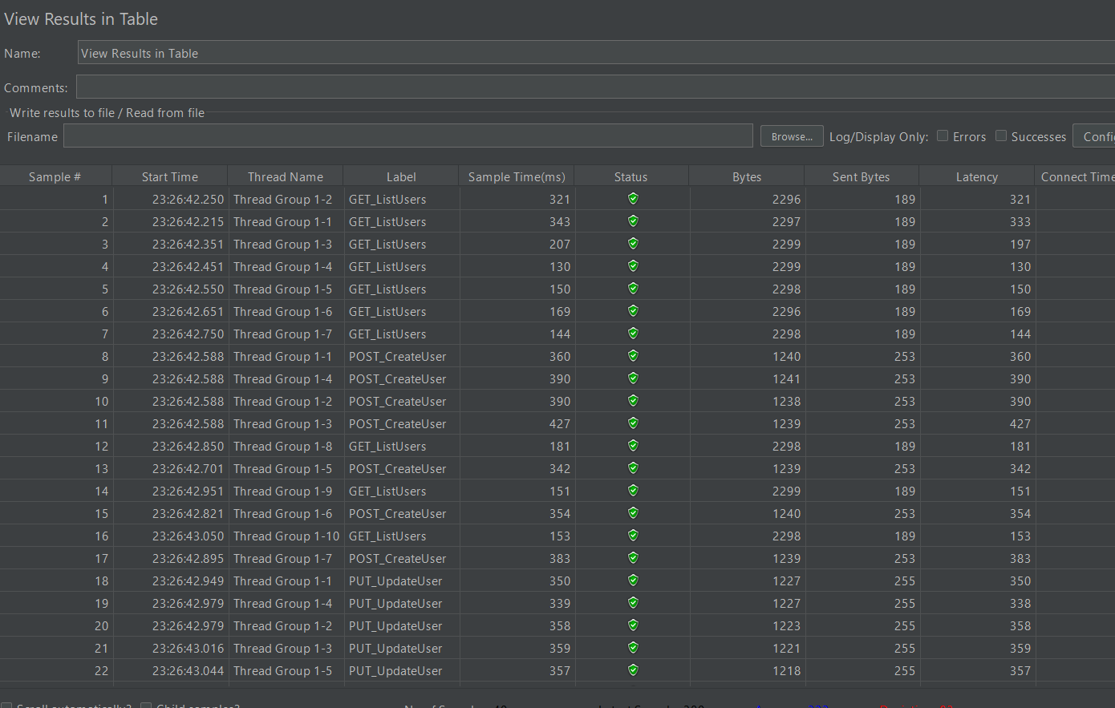
Responses of the API of the JMeter with Result Table

Slide 18
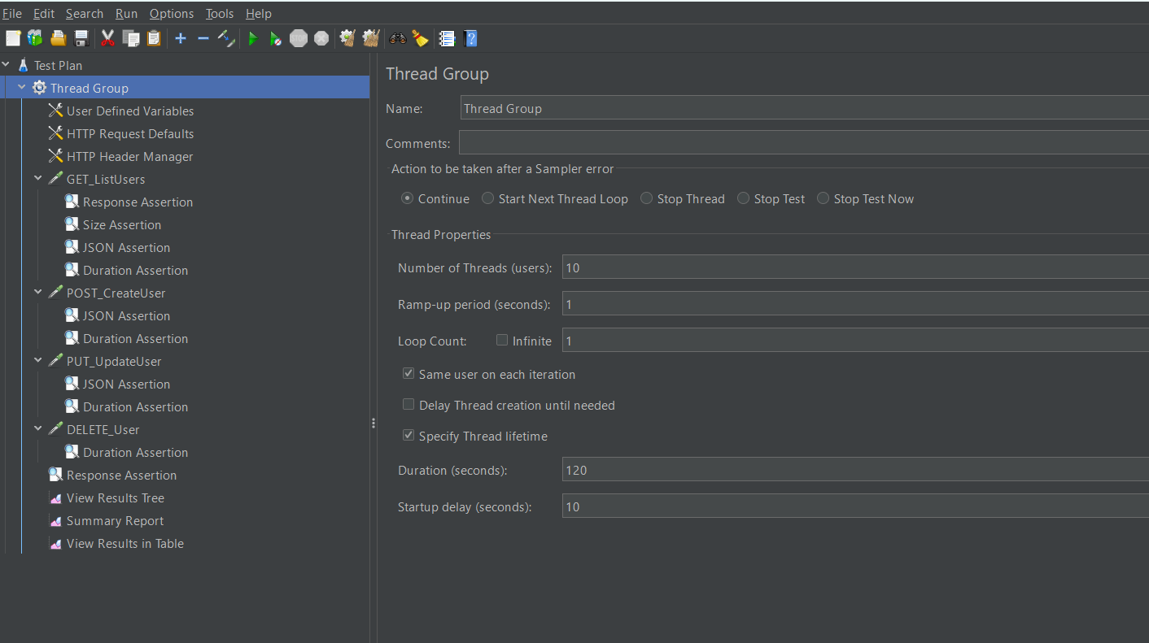
Thread Group Configuration

Slide 19
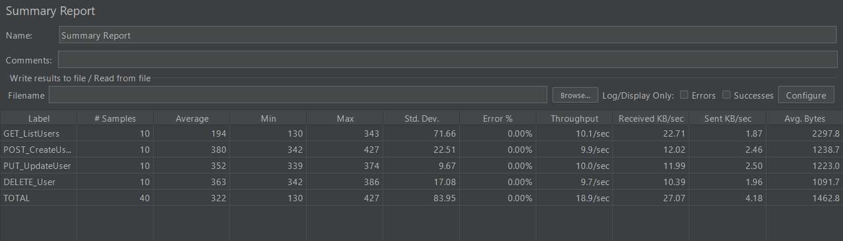
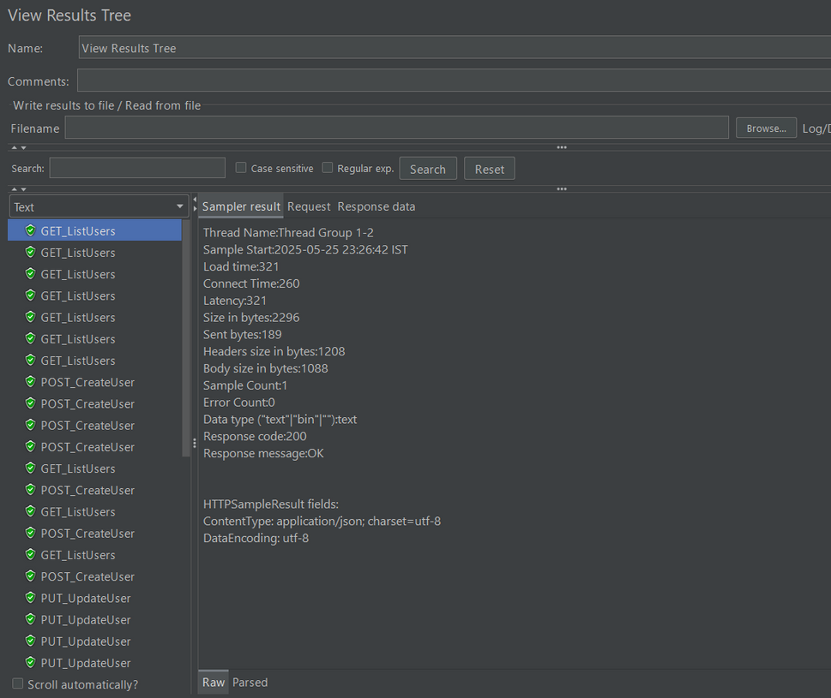
Summary report
Result Tree

Slide 20
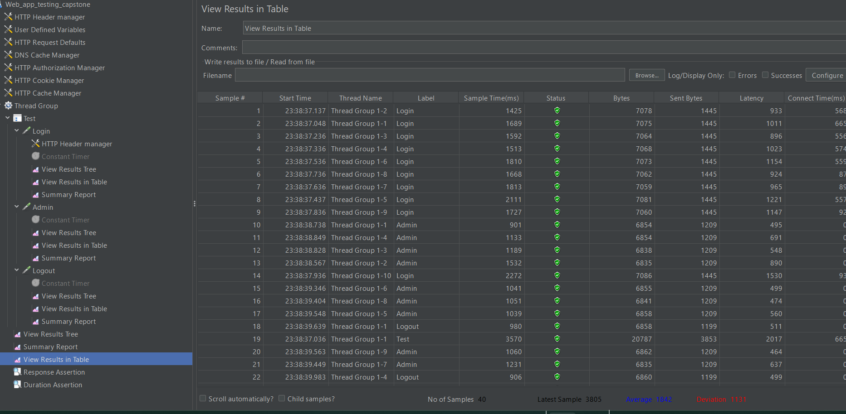
Responses of the Web APP of the JMeter with Result Table

Slide 21
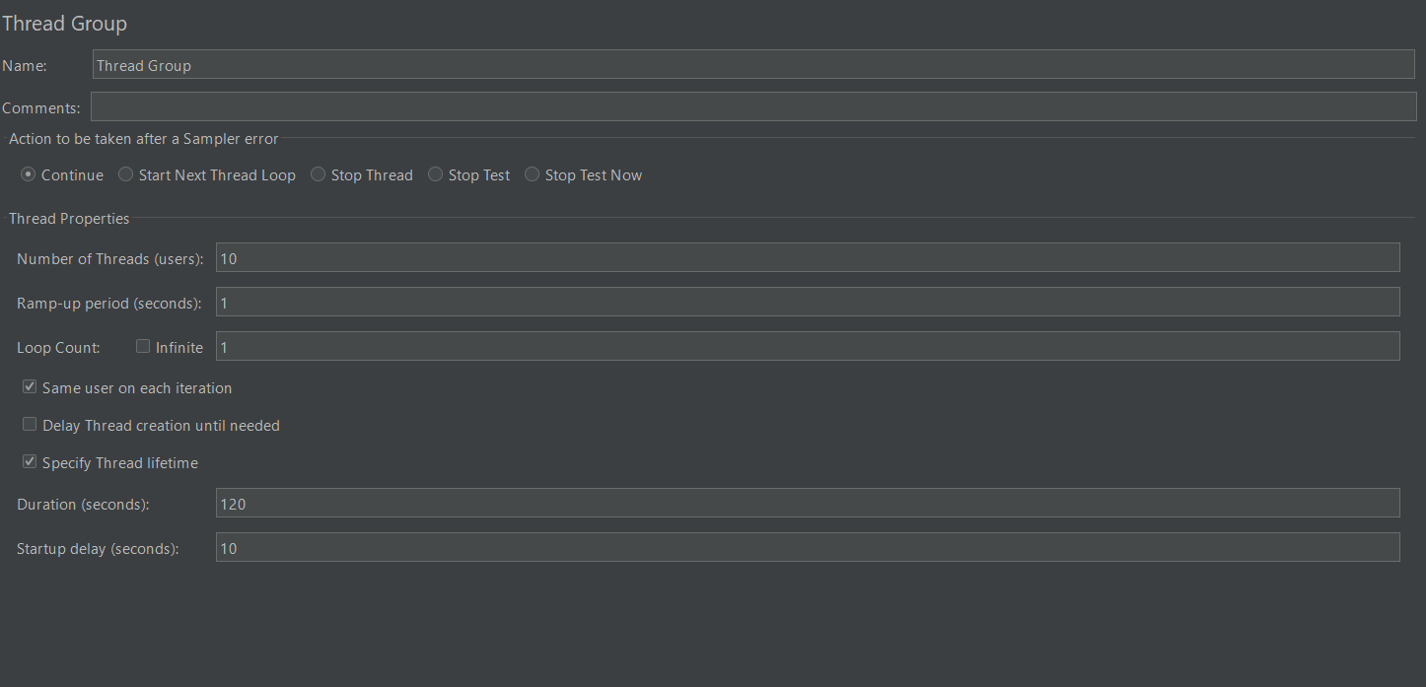
Thread Group Configuration

Slide 22
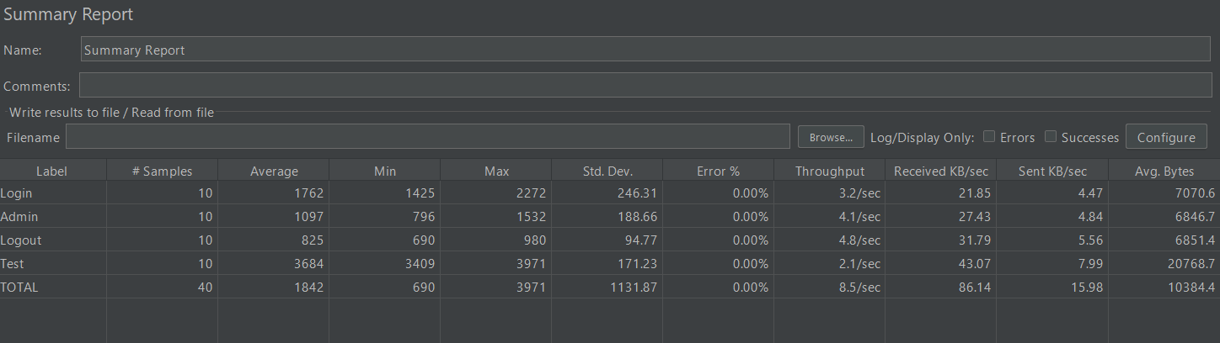
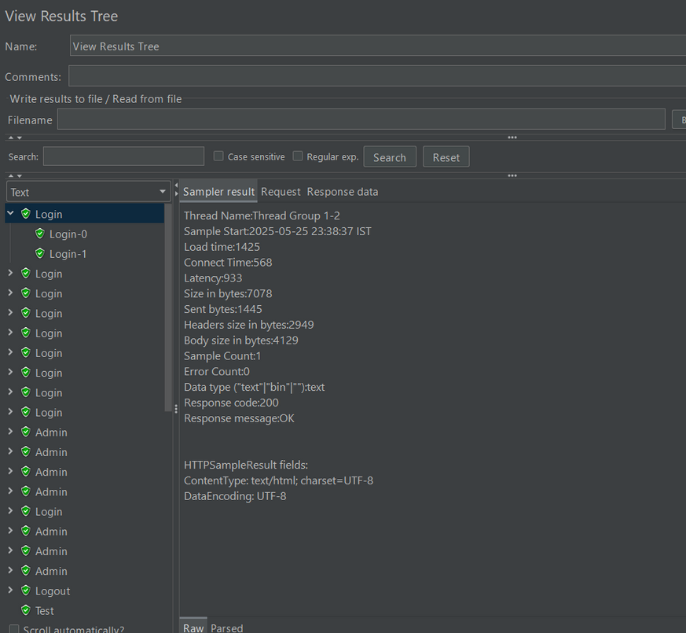
Summary report
Result Tree

Slide 23
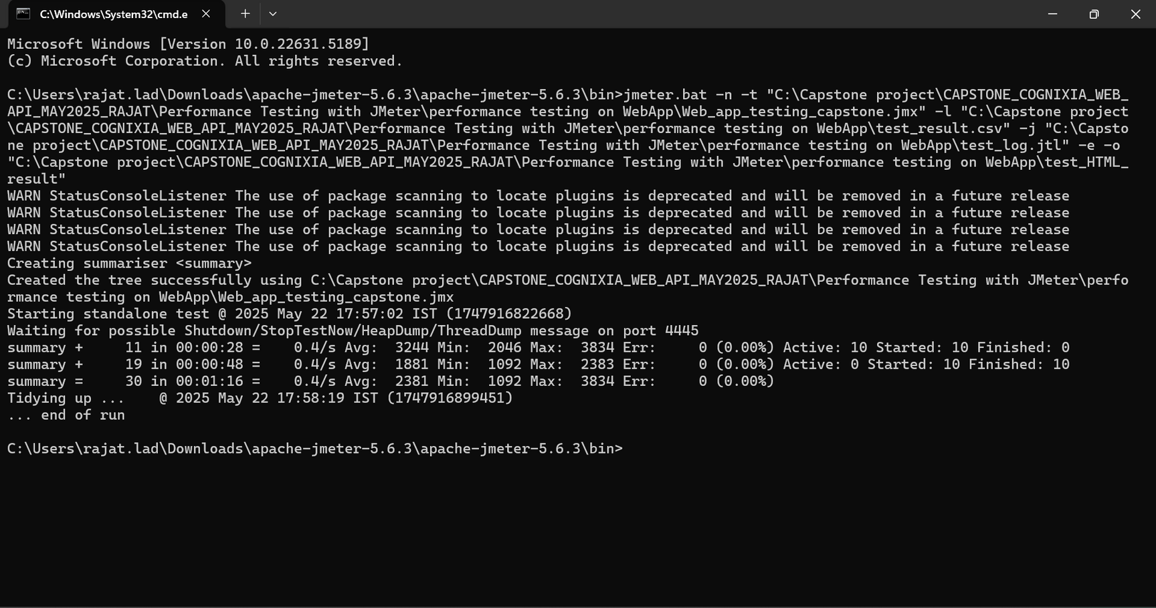
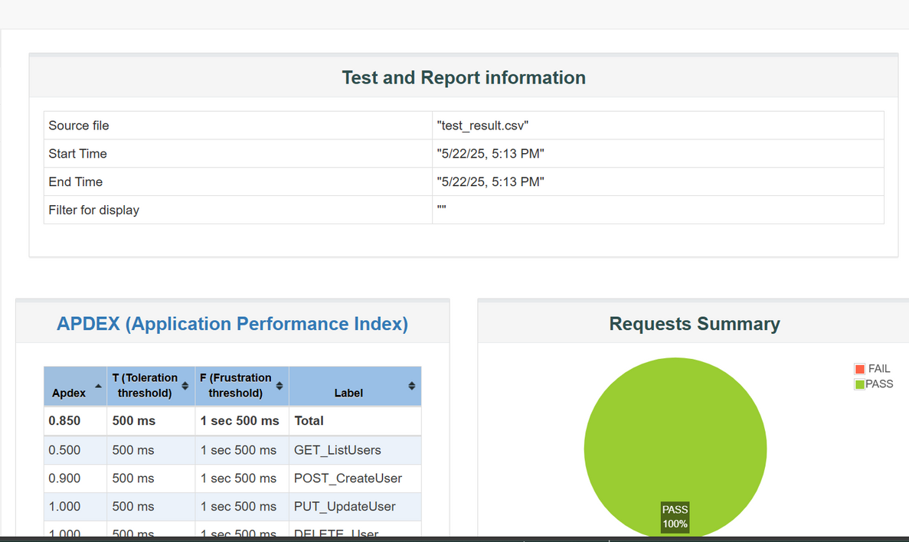
Results and HTML Report Generation of .jmx file using CLI
HTML Report

Slide 24
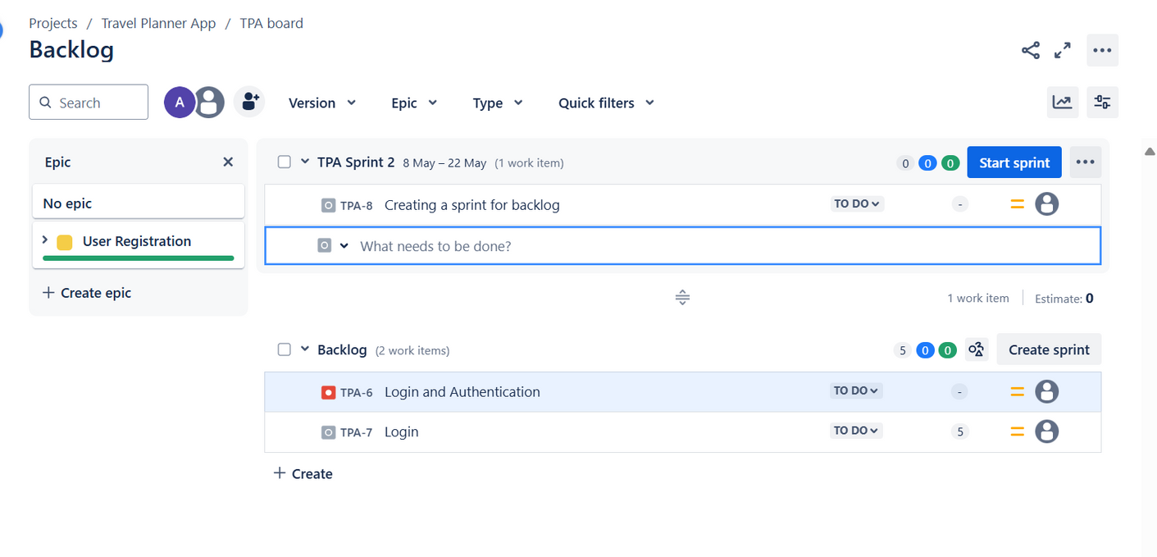
JIRA - DASHBOARD
Key Features Tracked:
Sprint Summary & Active Sprint View
Epics, Stories, Tasks, and Backlog Items
Test Cases, Executions, and Pre-conditions (via Xray)
Dashboards & Custom Filters with execution screenshots
Sprint Planning Board

Slide 25
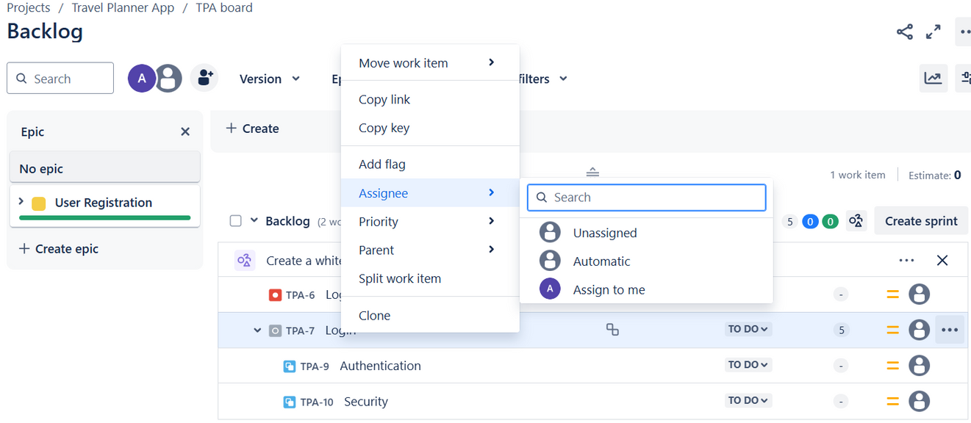
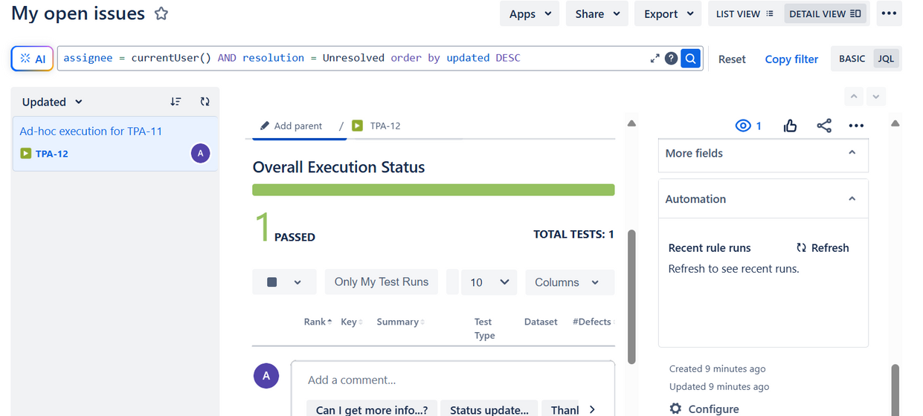
JIRA - DASHBOARD
Linking Issues
TEST EXECUTION RESULTS USING XRAY​

Slide 26
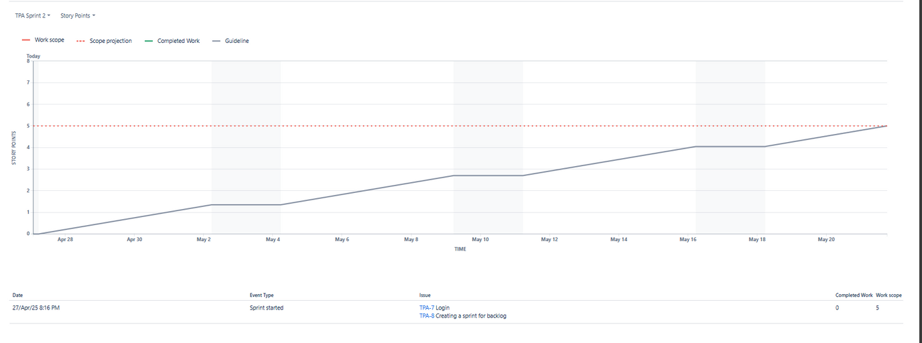
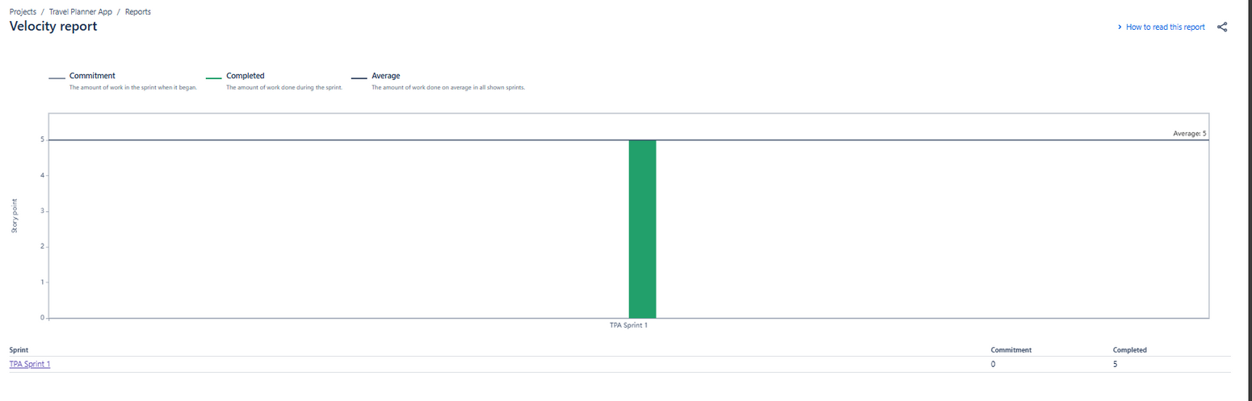
JIRA - DASHBOARD
Burnup Chart
Velocity Chart

Slide 27
Conclusion
GAINED COMPREHENSIVE QUALITY ENGINEERING SKILLS ACROSS MANUAL, AUTOMATION, API, MOBILE, AND PERFORMANCE TESTING.
DEVELOPED AND MAINTAINED SCALABLE TEST AUTOMATION FRAMEWORKS USING INDUSTRY TOOLS AND BEST PRACTICES.
DESIGNED STRUCTURED SELENIUM WEB UI TEST CASES USING JAVA, TESTNG, AND THE PAGE OBJECT MODEL (POM) FOR MAINTAINABILITY AND SCALABILITY.
MANAGED END-TO-END TEST EXECUTION, REPORTING, AND DEFECT TRACKING EFFECTIVELY USING JIRA AND XRAY..
BUILT AND VALIDATED POSTMAN API TESTS COVERING MAJOR HTTP METHODS (GET, POST, PUT, DELETE), WITH CHECKS ON STATUS CODES, RESPONSE BODY, HEADERS, AND PERFORMANCE.
STRENGTHENED PRACTICAL EXPERIENCE WITH MOBILE AUTOMATION AND PERFORMANCE TESTING TOOLS.

Slide 28

Thank You

